Slide 1
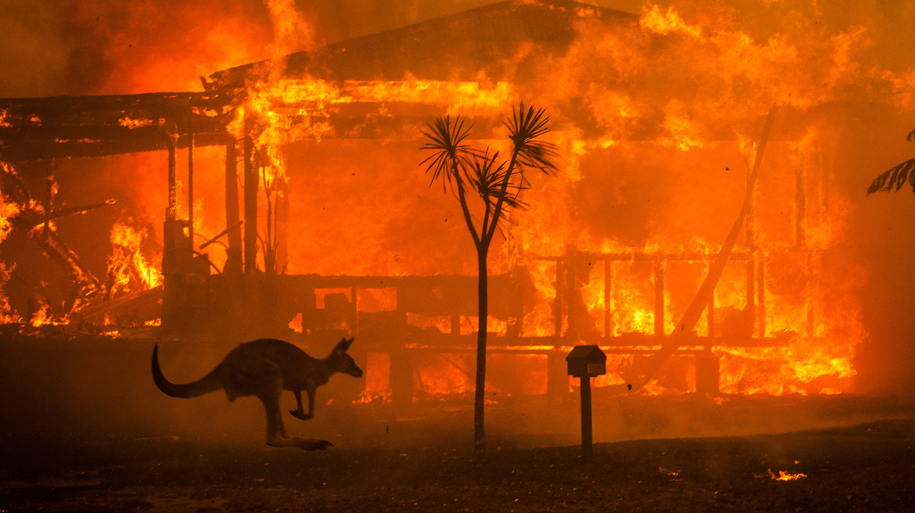
EMERGENCY MANAGEMENT
Australian Bushfires & Ambulance

Slide 2
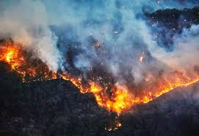
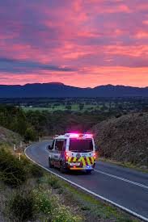
Slide 1: Project Overview
Bushfires:-
The main objective of the project is to find out which areas rise huge risk for bushfires across Australia and developing a website which gives out information for all regions which have frequent bushfires.
Ambulance

Slide 3
Slide 2: Deliverables of the Overall Project
Task | Members | Technologies
Data Sourcing | Nithin, Mohan, Nikhil Reddy, Nikita , Bala, Varsha, Vijay | Various website
Data Cleaning | Nithin, Bala Tharun | Python
Prediction Analysis | Aiswarya ,Nithin, Mohan | Python
Data visualization | Pavan ,Piyush , Nikhil ,Simran, Shikhar | Tableau, GIS
UI | Simran ,Nikita ,Varsha, Hamza, Pavan | Simran, Hamza, Pavan
Main deliverable:
finding out areas which are highly prone to bushfires
creating a website which gives out information on bushfires across Australia and provides precautions with details of the nearest fire brigade
finishing the ambulance data by plotting graphs by using python/Tableau

Slide 4
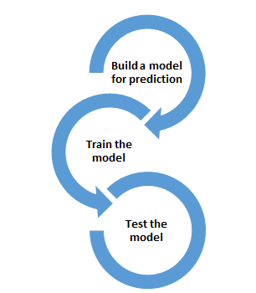


Visualization
Creating website
Data sourcing
Data cleaning
Methodology/Process

Slide 5
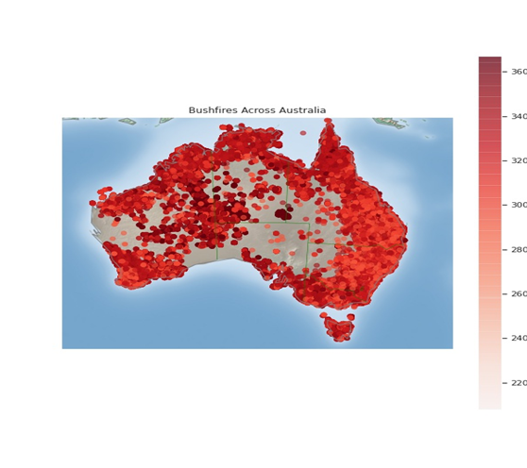
Slide 3: Deliverables of this iteration
The main goal that we tried to achieve until now is to predict areas which are prone to bushfires by using different models and create a website which gives out information about bushfires
This graph shows the total number of bushfire cases across Australia. The fires have different levels of intensity which is demonstrated by the color map

Slide 6
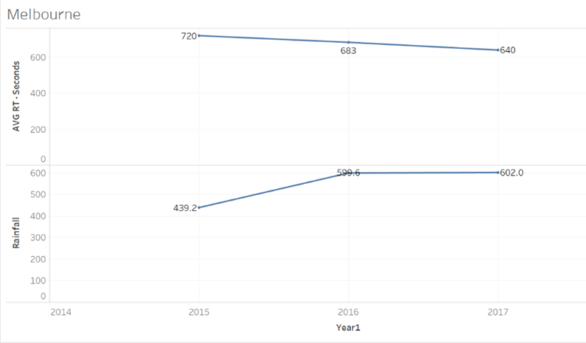
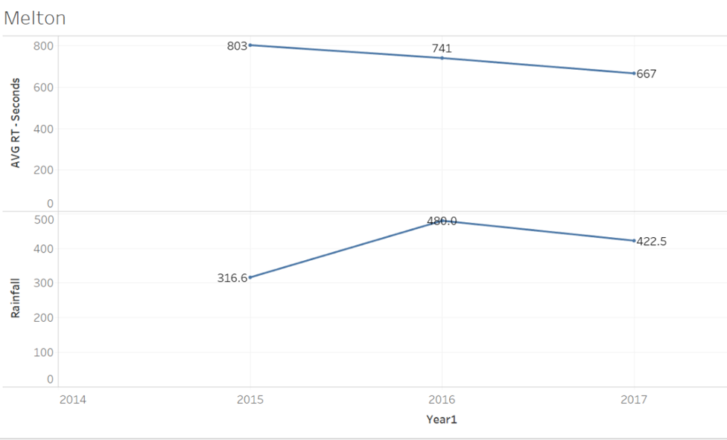
AVG Response time Vs Annual Rainfall data

Slide 7
Prediction analysis
We have chosen a dependent variable as a state for the first model, i.e. logistic regression which is used after encoding the categorical data, the accuracy of this model is 0.86
the prediction variable have features such as probability which can provide the likelihood of bushfires for different places with under various conditions
we used multinomial Logistic Regression by taking suburbs as dependent variable with which has an accuracy of 0.86

Slide 8
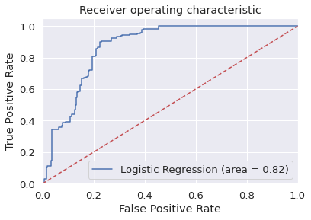
From the prediction analysis we can see that suburbs such as Bairnsdale which is above 38-degree Celsius had the highest probability of bushfire with 0.879
the areas with temperatures lower than 12 -degree Celsius and humidity <30% had fewer chances of bushfires with 39%
hence proved that weather conditions have an impact on bushfires

Slide 9
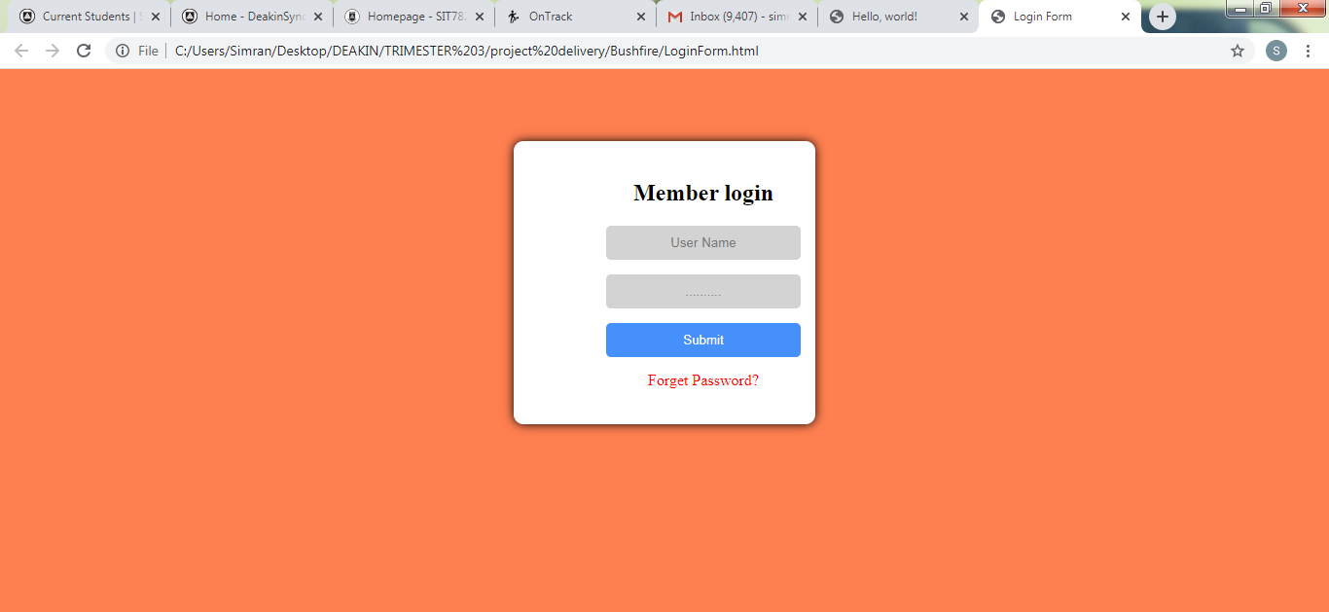
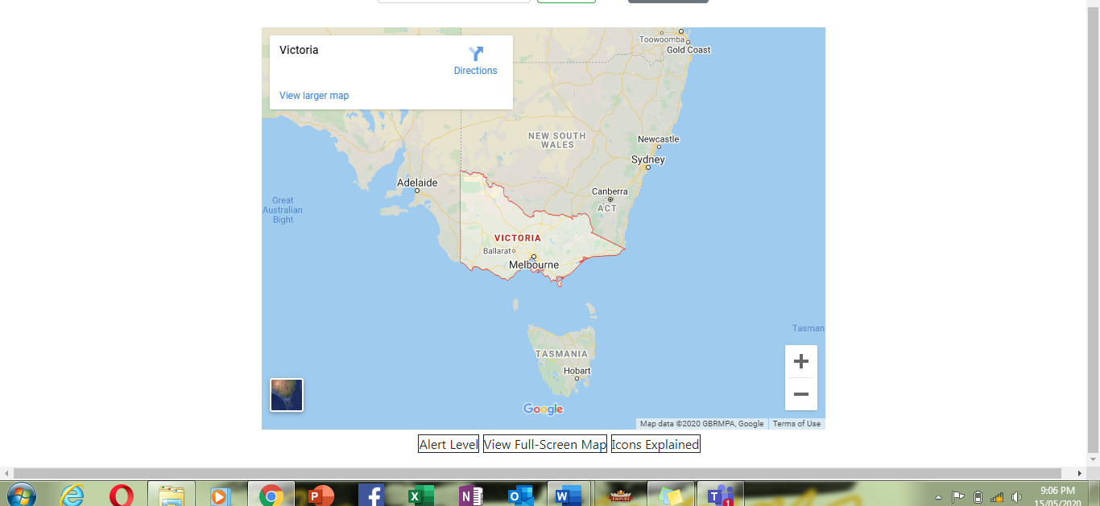
Bushfire website
We have created access page for general public use and a made main page with Victoria map
To create the website we are using atom software where we run html code

Slide 10
Demo Slide: Feature/task completed in this iteration
Use the slide to show / discuss:
How and who achieved the task
How this feature/task contribute to the overall project
Live demonstration or a video (preferred)
Challenges you faced and how you overcame them
Demonstrate or otherwise show the feature in operation

Slide 11
Team Contribution
Team Member | Major Contribution(s) | Hours Recorded
Pavan Vadla | Data Sourcing, Visualization of Ambulance Victoria Data, Predicting future Emergency Requirements and final documentation.
Nikita Shishupal Dighe | Mentoring and Managing, Distribution of tasks, Data Sourcing, Preparing User Interface, Planning and execution of UI, Presenting the presentation
Aiswaraya Subrahmanian | Data sourcing for bushfire and weather data. Created heat maps for data. Did reverse geocoding for the bushfire data. Created models for prediction. Found probabilities of bushfires in various places across Australia. | 106
Vijay bathini | Data souring, making presentations and Data Cleaning
Bala Tharun Reddy Shymala | Data Sourcing for Bushfire, Data Cleaning, extraction of weather data in respective with the bushfire locations | 83
Simran Rashpal Dhillon | Planning of UI design, Wireframe representation, Implementation and Execution of UI

Slide 12
Team Contribution
Team Members | Major Contribution(s) | Hours Recorded
Mohan Kiran Bandaru | Visualization using Tableau and Python( time series for Canberra) Data sourcing for bushfire locations Documentation and it is showcased in folder "Mohan" Prediction analysis using multi linear regression model | 84
Hamza Zulfiqar | Data extraction for the bushfires, got familiar with python for my part in Iteration 2, learnt how to plot graphs and visualize data in python, UI | 70.5
Shikhar Dhyani | Data sourcing, documentation of presentations, upskilling in python, using python to create graphs for data analysis in iteration 2
Piyush Gandhi | Data Sourcing, Analysis and Visualization of Ambulance Victoria Data, Predicting future Emergency Requirements.
Nithin Reddy Gundre | Data Sourcing, Extracting weather data, Visualisation, Documentation of UI (prototype) | 74
Nikhil Reddy Viraati | Data Sourcing, Data visualization, Working on the previous year's project Ambulance Data, Extracting Weather data relevant to the Bushfire Data. | 80
Varsha Shankar | Data Sourcing, planning to conribute in UI design and final documentation

Slide 13
Plan for the next iteration
For the next iteration we will try to complete the website which includes
A map of Australia with areas which are prone to bushfires
The website gives out information about ongoing fires and provides with emergency hotline numbers

